Slide 1


CMPE 211 Course Project
Project Name: TEDUpolly
Group Name : La Petit Project (Section 1)
Group Members :
• Fuat Yiğit KOÇYİĞİT - 16429085948
• Günsu GÜNAYDIN - 18098680134
• Sudenur ATA - 10014062970
• Yunus NOGAY - 41953436140

Slide 2
Contents
Rules and Instructions of the Game
General Design of the Classes
Giriş Class
WhichPlayerStart Class
Square Class
Player Class
Board Class
Dice Class
Finish Class
Ev Satımı Class
Main Class

Slide 3
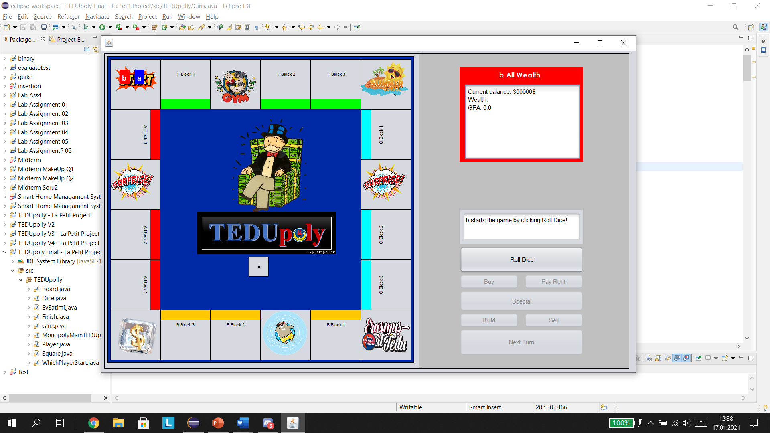
Rules and Instructions of the Game
The game have a board, panels and 7 button.
Firstly, there will be a dice throw to specifiy the play order.
Then, game will start according to that order. First student will throw the dice.
Students will start the game with $300.000 money.
Able to buy the place if it is not owned by another student and if he/she has enough money to buy.
If another player has that place, he/she had to pay rent.
If he/she doesn’t have money to pay, the game will want from him/her to sell something until he/she has enough money to pay the rent. If he/she still doesn’t have enough money, student will de-registrate and lose the game.

Slide 4
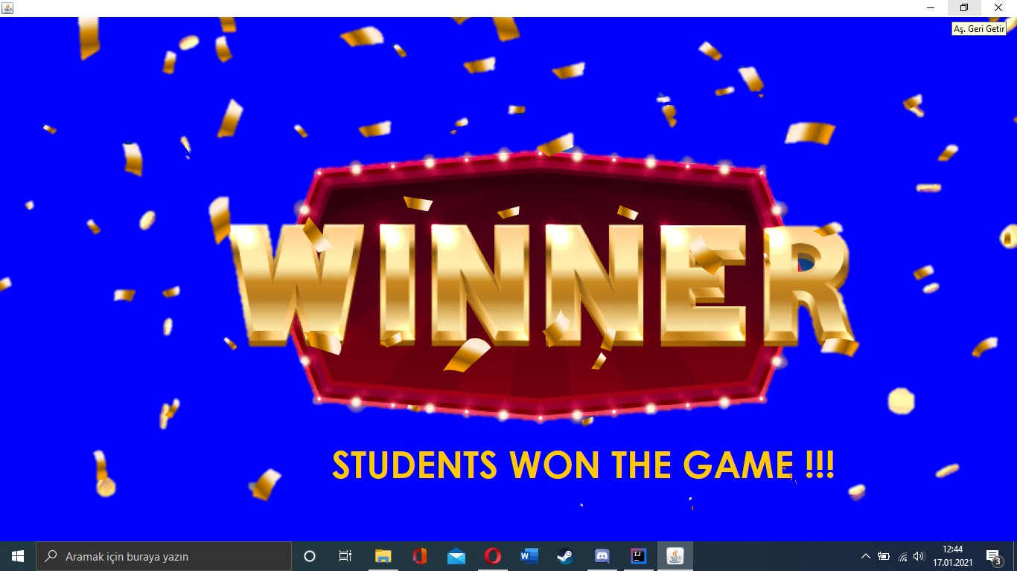
Rules and Instructions of the Game
Registration Freeze” square will make student freeze the next turn.
“Erasmus” square will cost student $25.000 money but will increase his/her GPA.
“Summer School” square will cost student $5.000 money but will increase his/her GPA slightly.
“Suprize” square will give student a suprize card.
Every dice of the student will be recorded as his/her grade. 1= 1.0 , 2= 2.0 , 3= 2.5 , 4= 3.0 , 5= 3.5 , 6= 4.0 and player will get scholarship according to his/her GPA.
The aim of the game is to finish the game as the richest and successeful student or eliminate other student and be the last one standing.

Slide 5
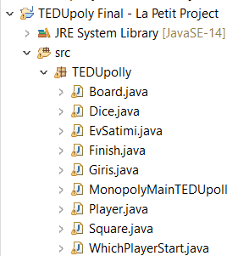
General Design of the Classes
Giriş Class
WhichPlayerStart Class
Dice class
Player Class
Square Class
Board Class
Main Class
Finish Class

Slide 6
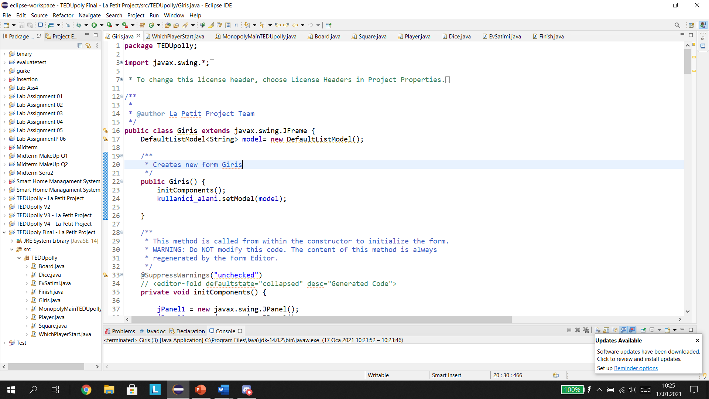
Giriş Class
User pushes to the Add player button to create players or pushes remove player button to remove a player.
After adding players, the WhichPlayerStart class will work.

Slide 7
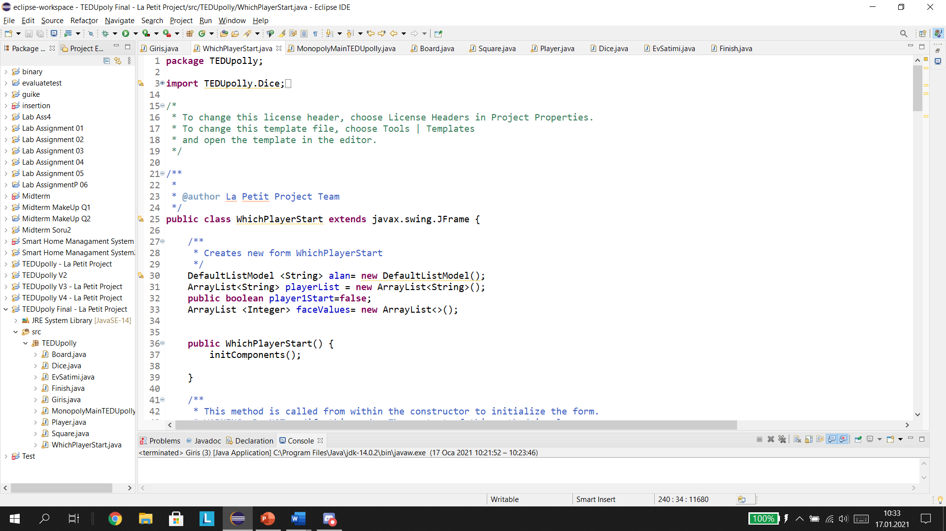
WhichPlayerStart Class
User rolls dice for 2 times.
Class determines the higher dice value.
If both values are the same, user needs to roll again.
After Rolling is done, player with higher dice result starts the game.

Slide 8
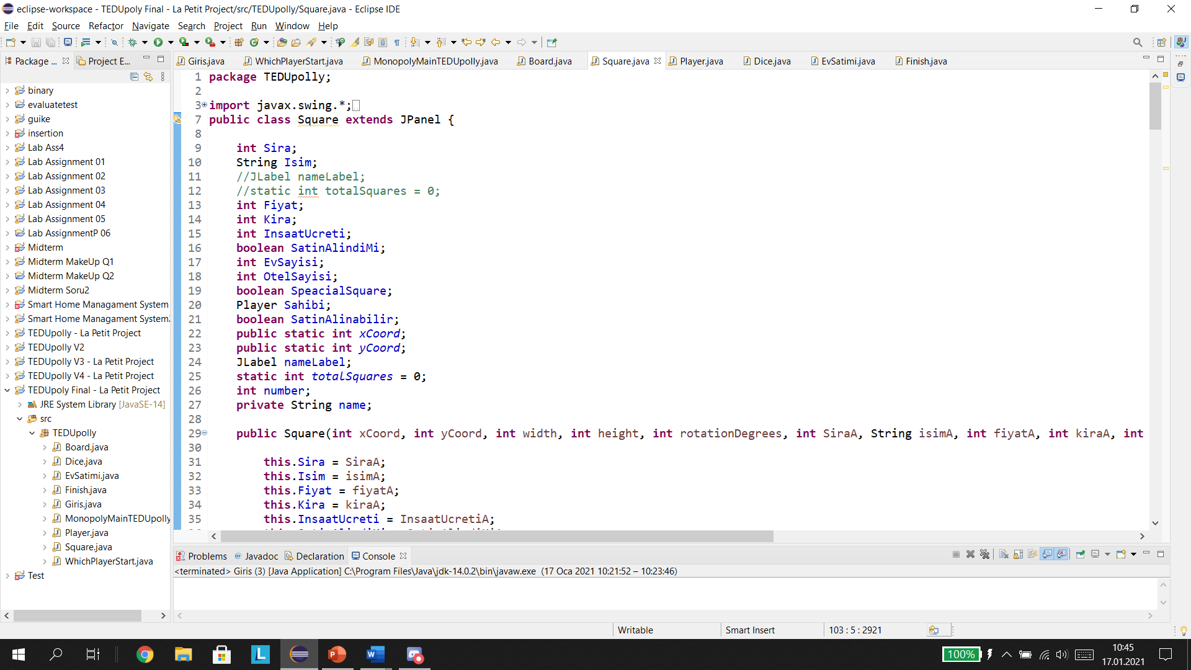
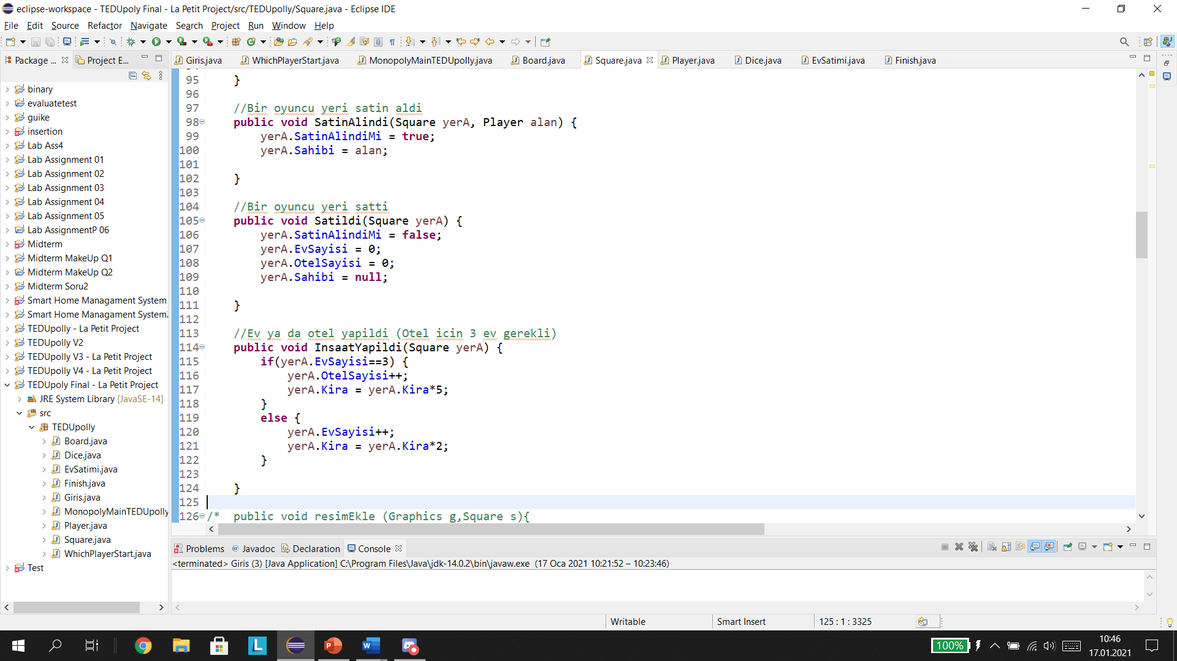
Square Class
X and Y coordinates, rotation degrees, place number, name, price, rent, build cost, is it bought, is it special, is it buyable, house count, hotel count and owner variables.
X Y cooridnates and rotation degrees are for creating shapes on board.
It has Satın alındı, Satıldı and İnşaat yapıldı methods.

Slide 9
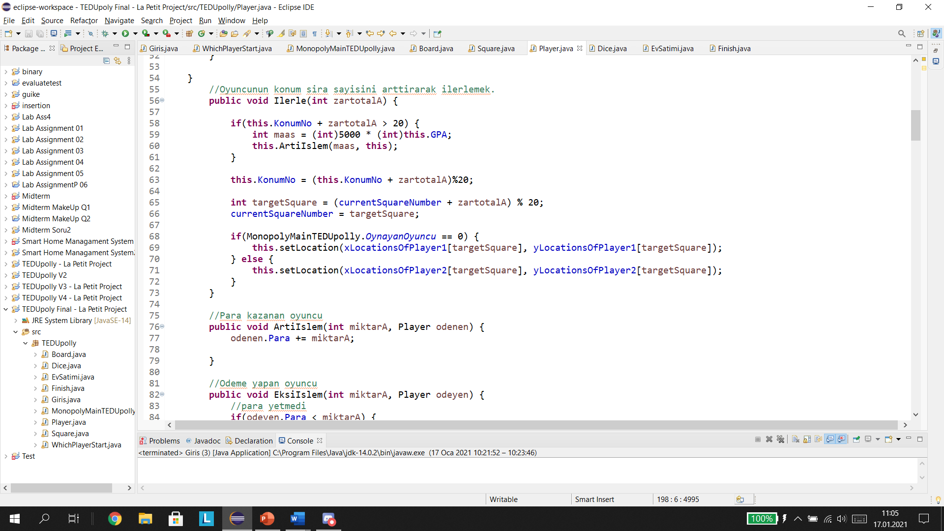
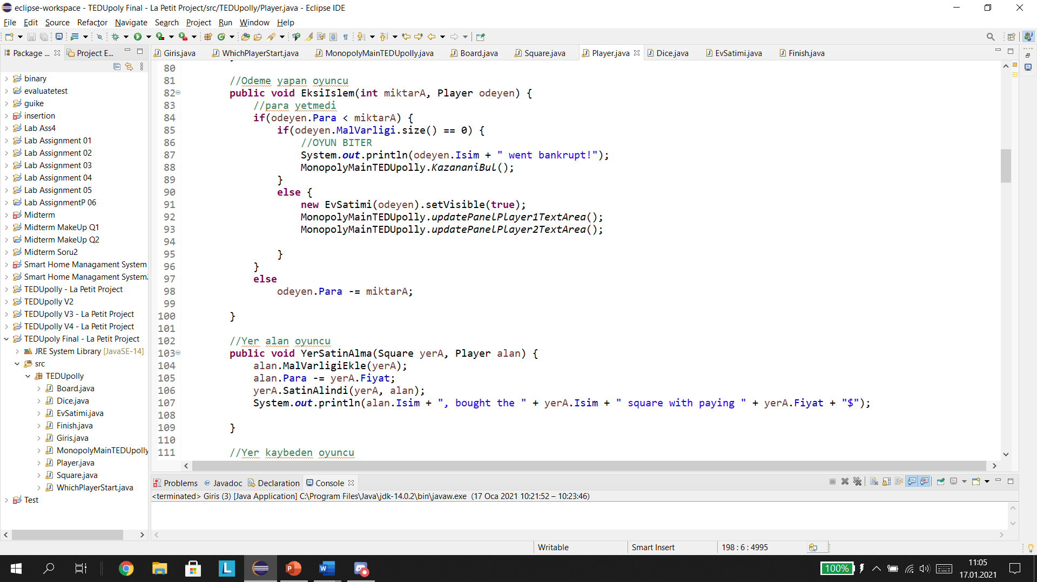
Player Class
have player number, name, first letter, money, gpa, wealth, location number, location square, grade total, player tour count and is it freezed values.
Have 13 methods

Slide 10
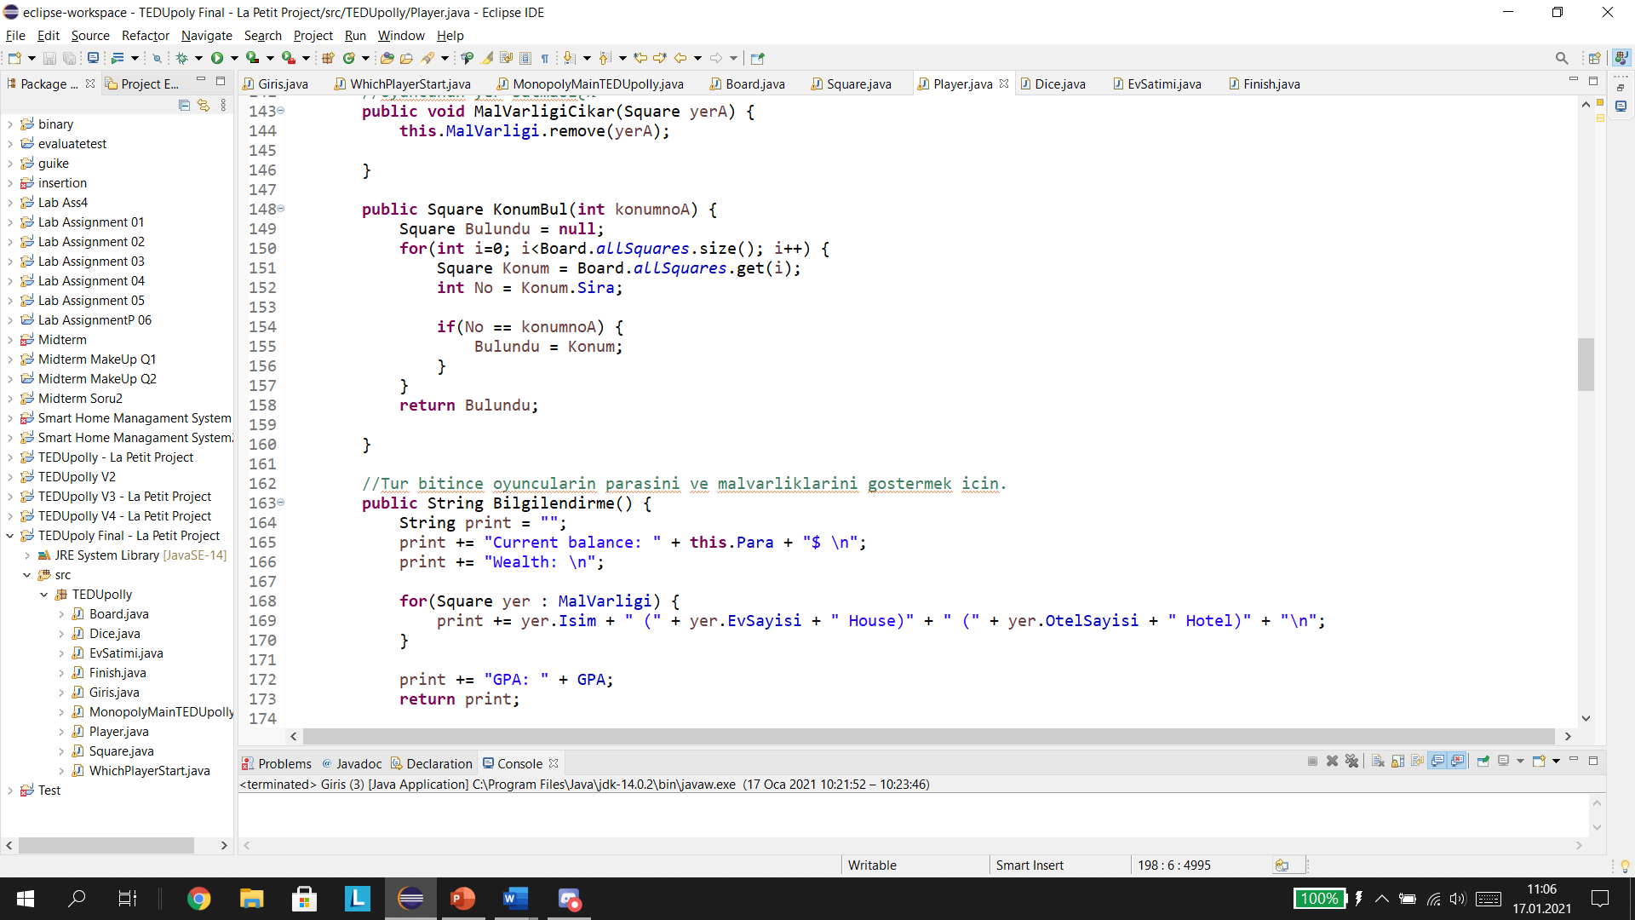
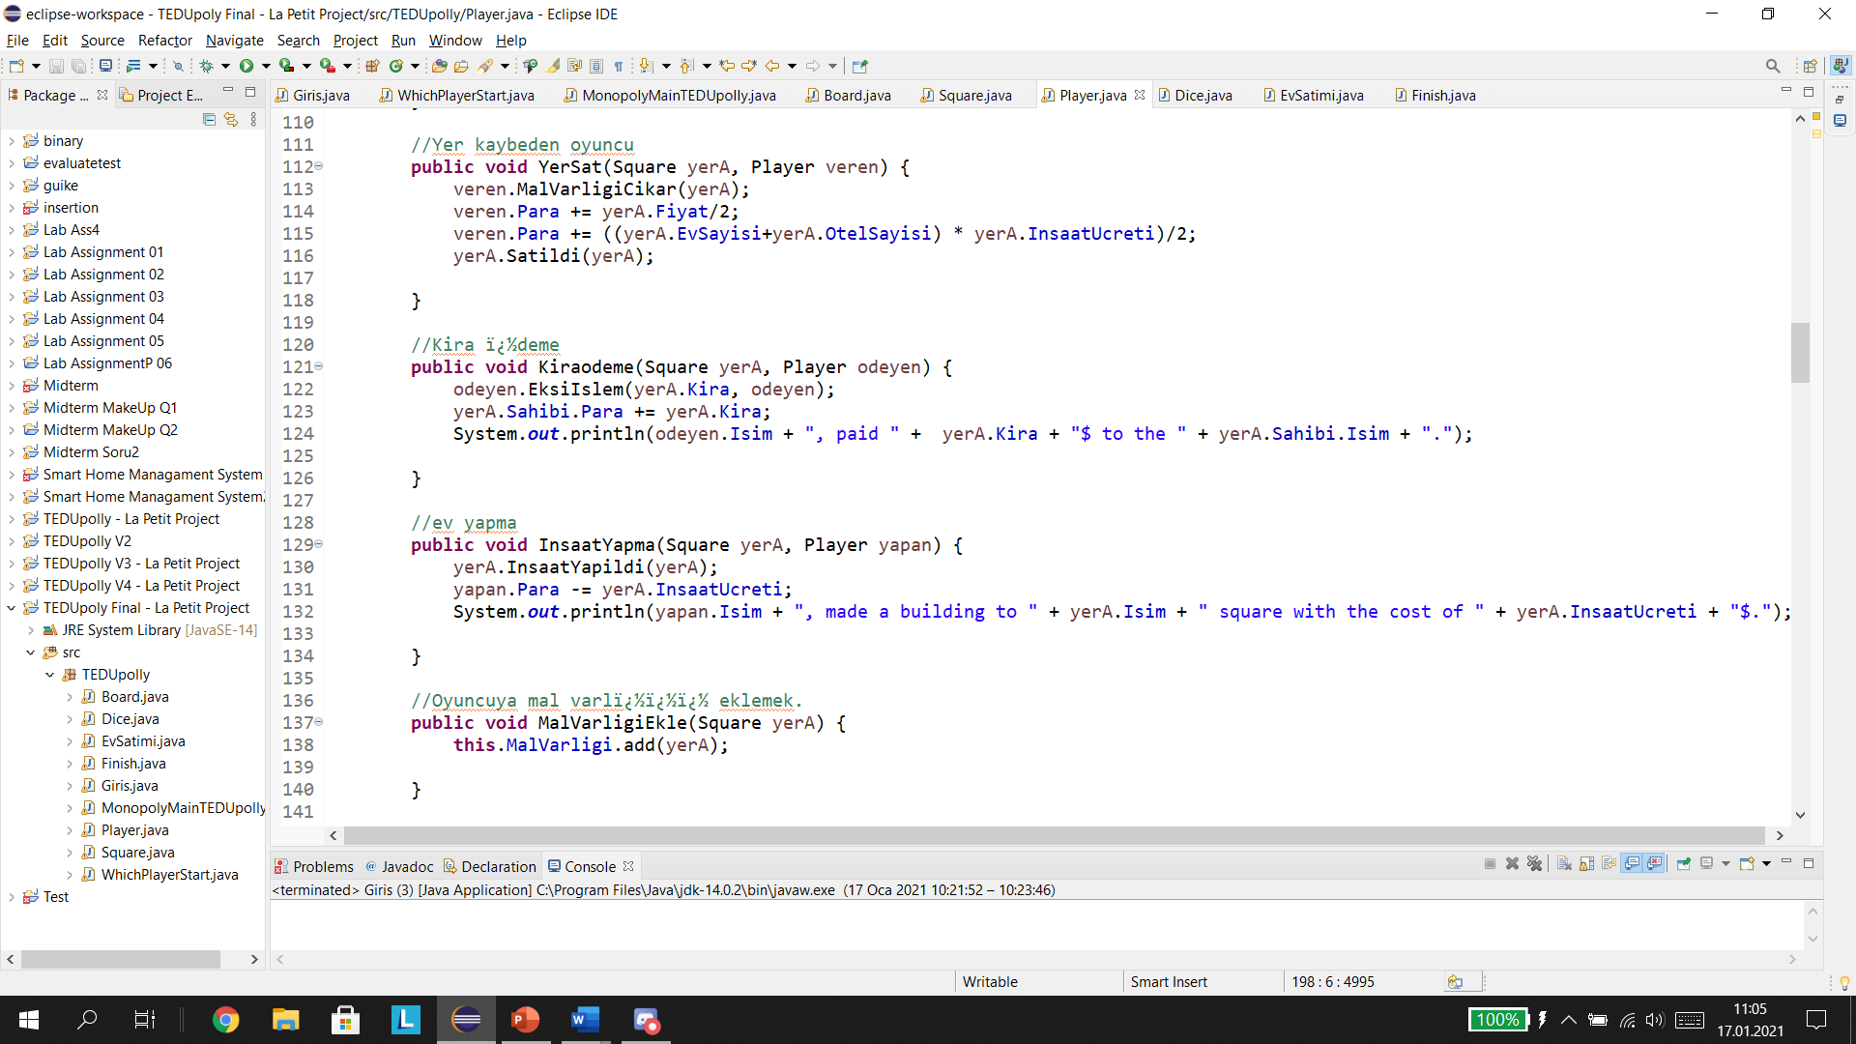
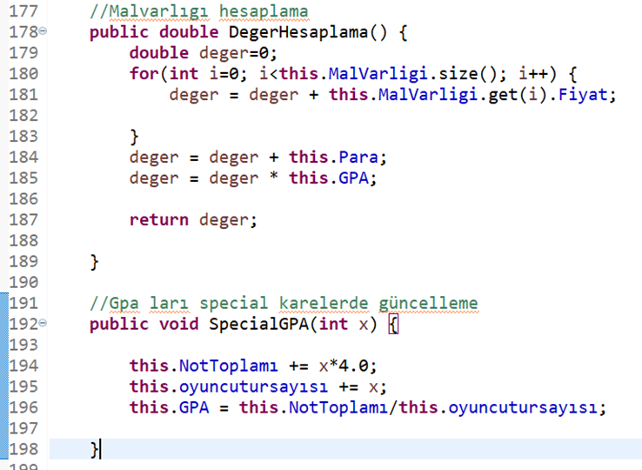

Slide 11
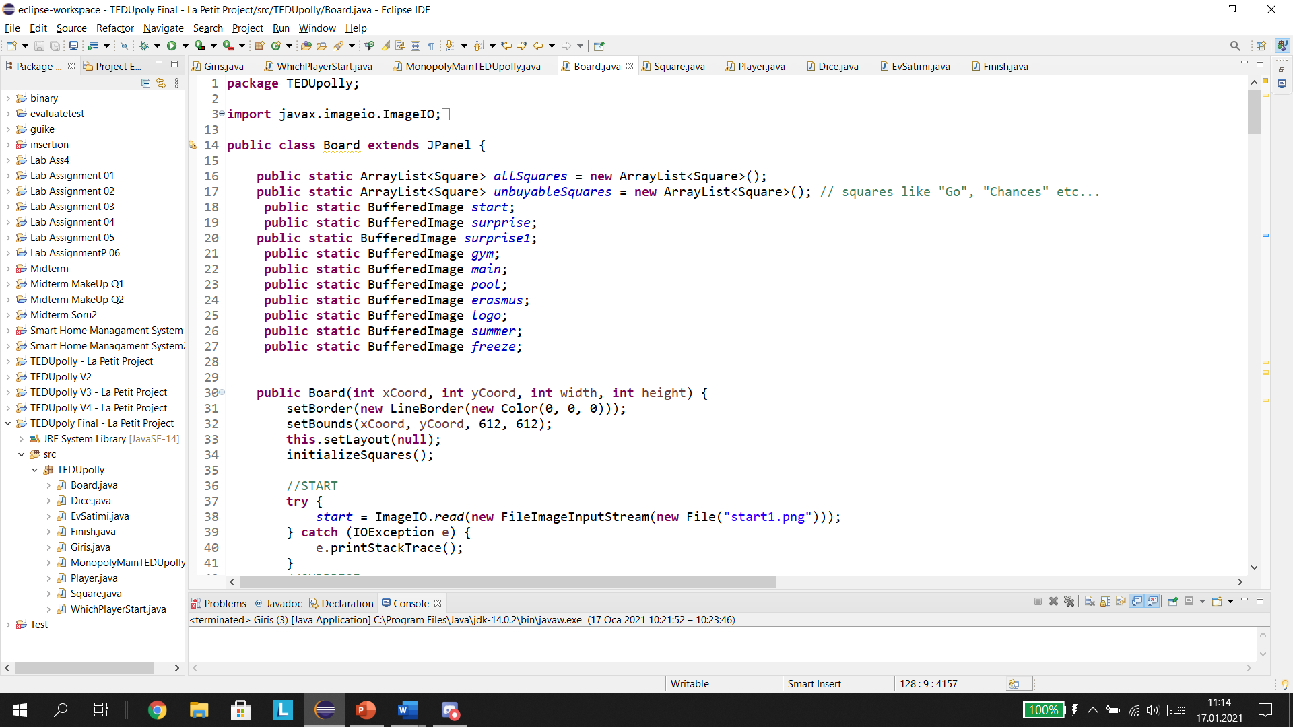
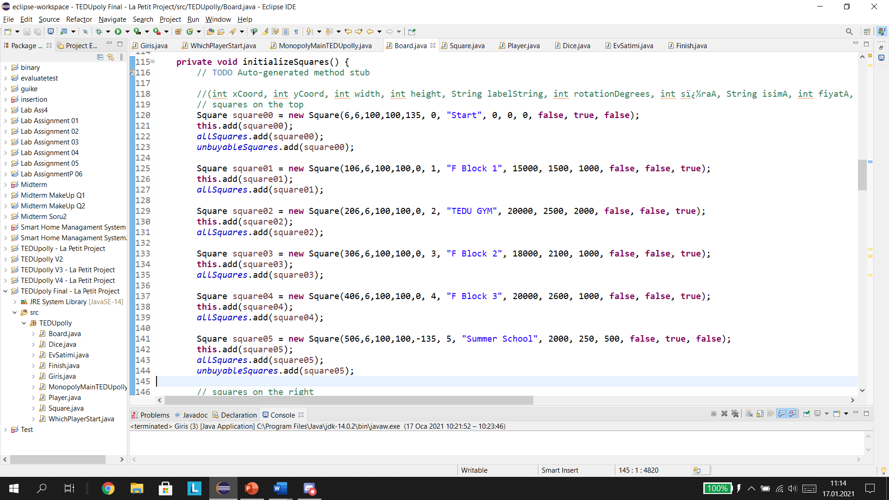
Board Class
Have paint and initializesquares method
Adjusting the pictures and creating the squares

Slide 12
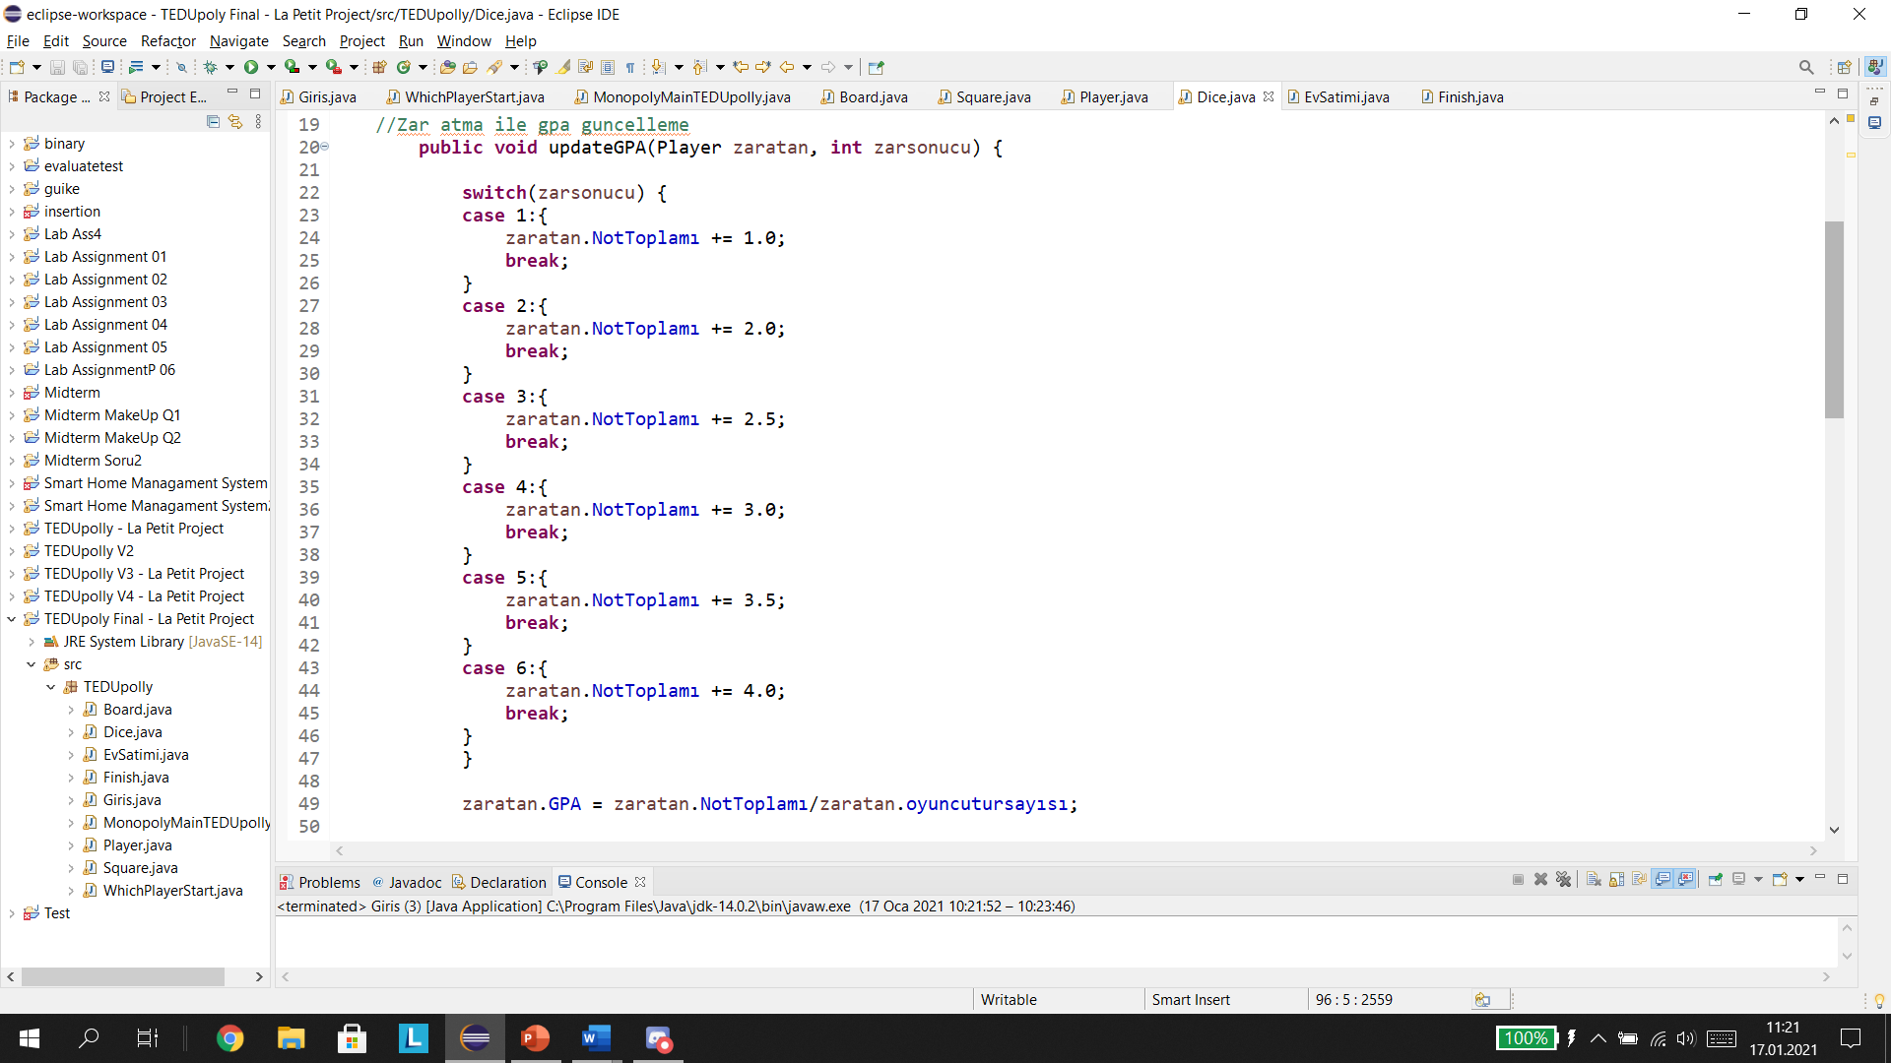
Dice Class
It has update gpa, paint component and zar at method.
For Rolling dice and updating gpa.

Slide 13
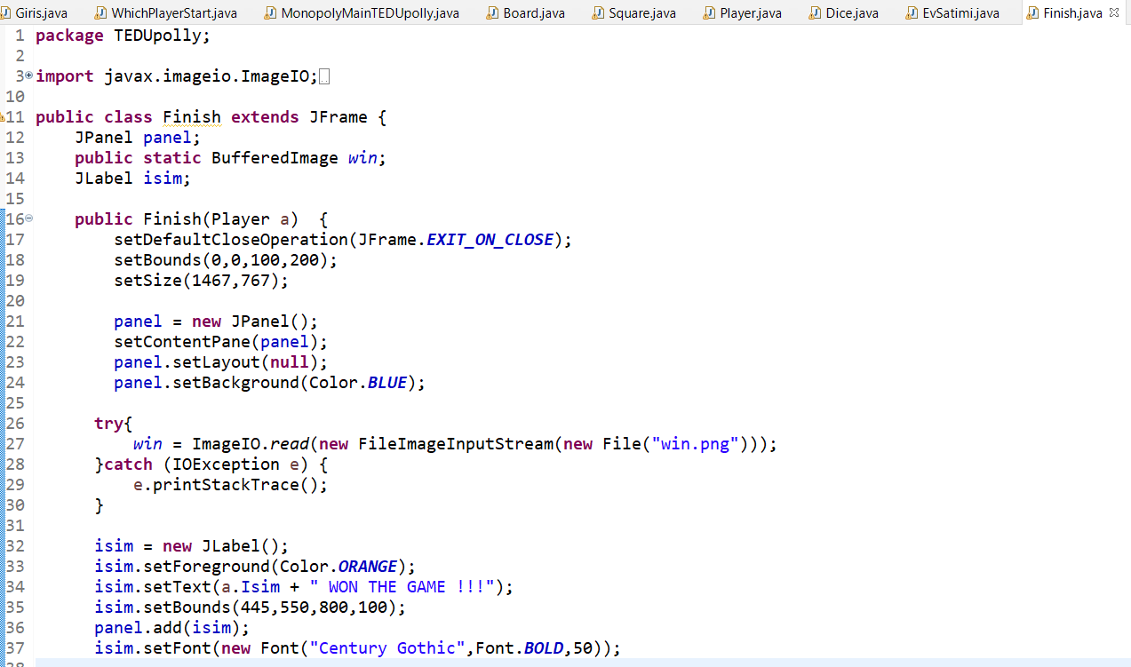
Finish Class
Works when a player bankrupted and has no way out.
Opens a frame with winning picture and announce.

Slide 14
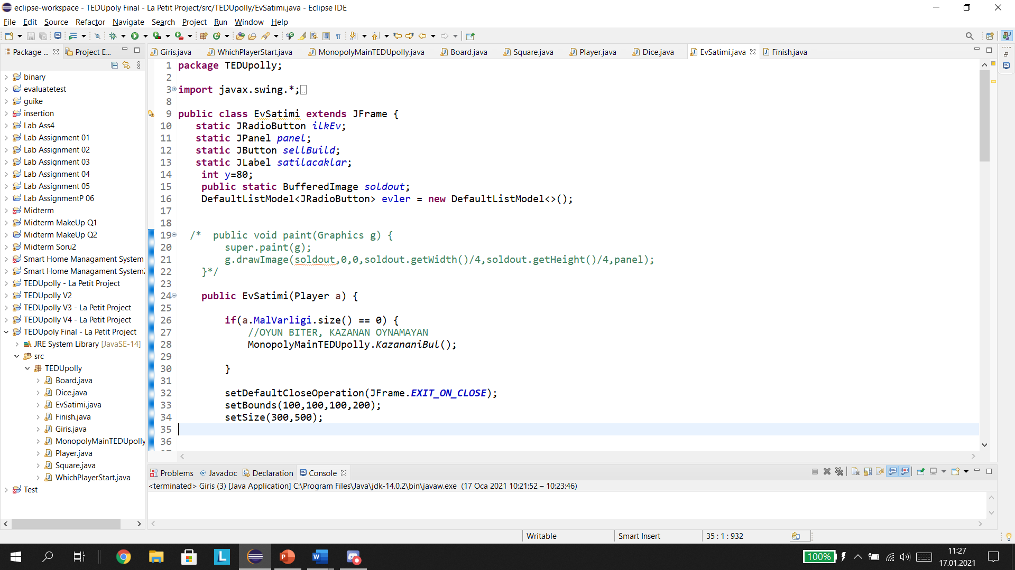
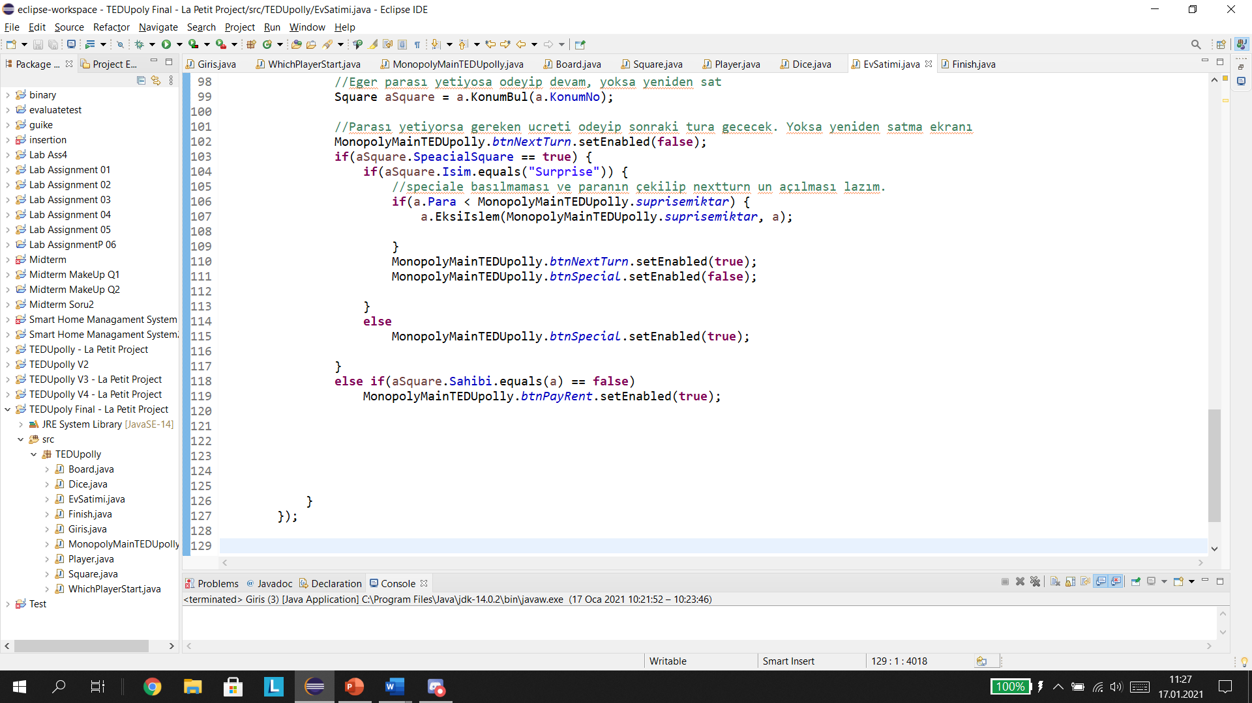
Ev Satımı Class
Works only when EksiIslem method is called and player hasn’t got enough money
User selects the squares and pushes sell button.
If the player has no wealth, this class calls the Finish class

Slide 15
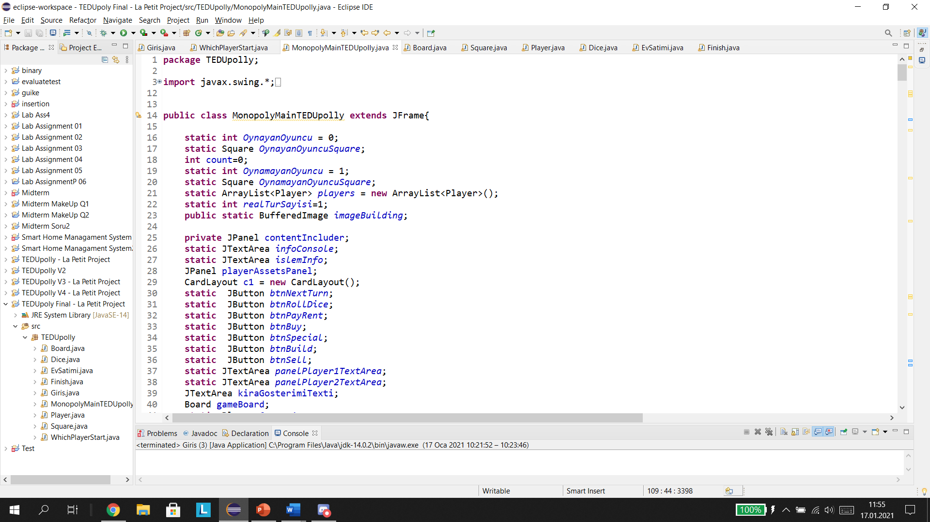
Main Class
Has NextTurn,RollDice, PayRent, Buy, Special, Build and Sell buttons in it.
All buttons has different jobs.

Slide 16
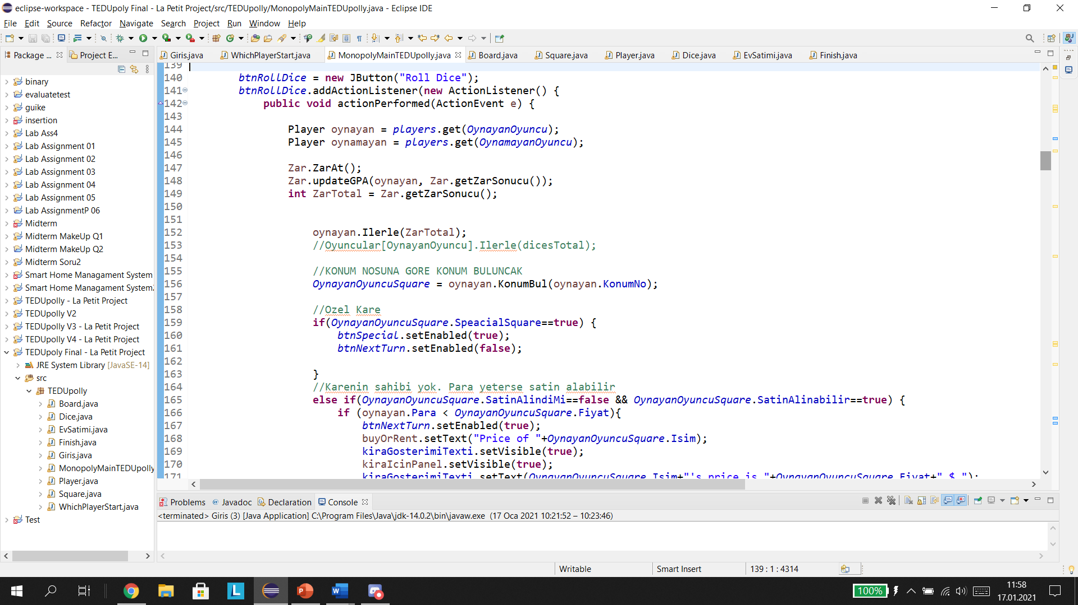
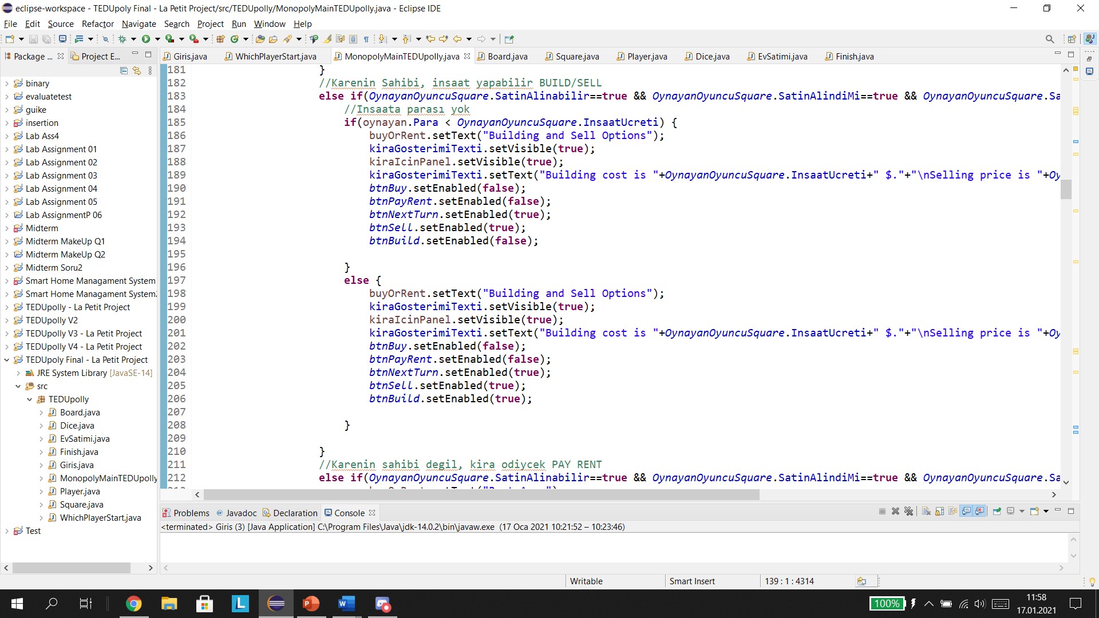

Slide 17
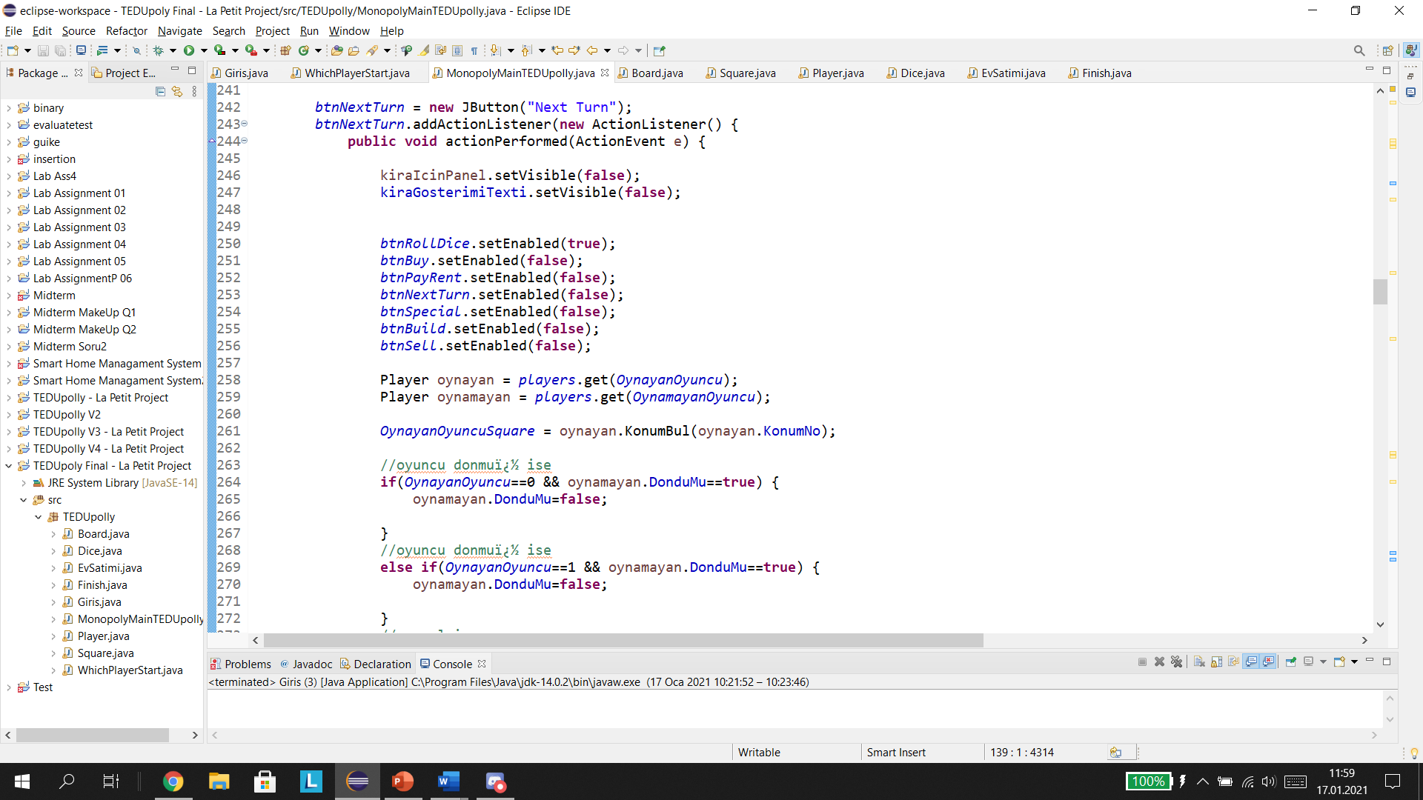
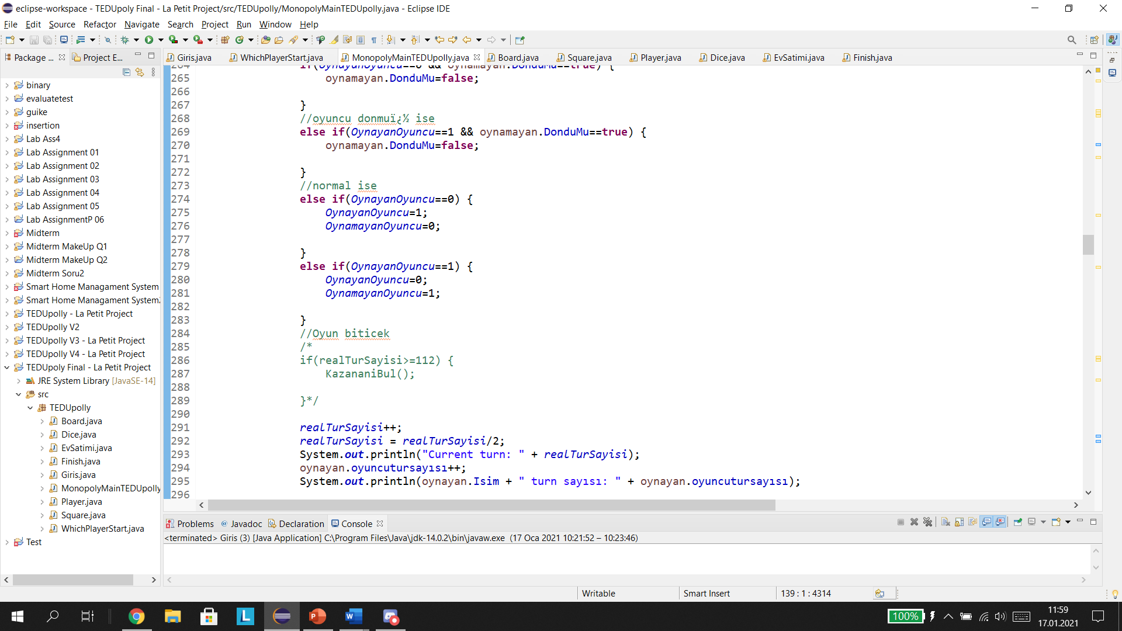

Slide 18
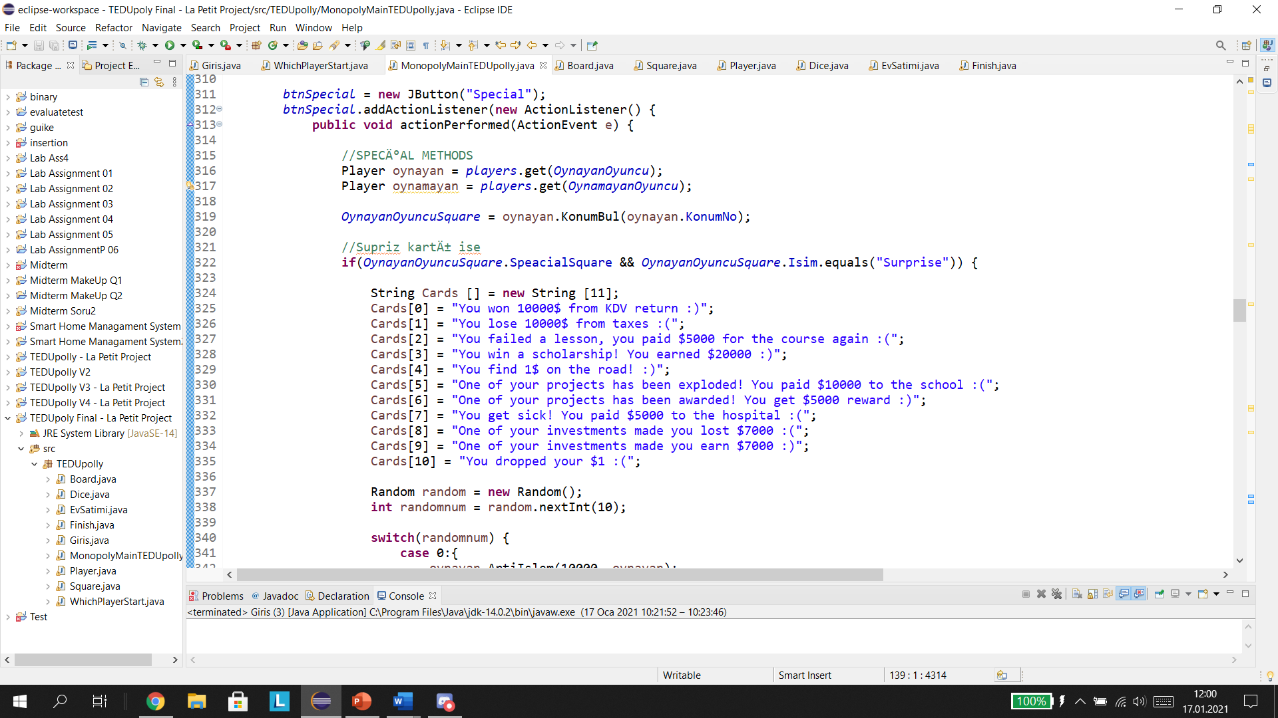
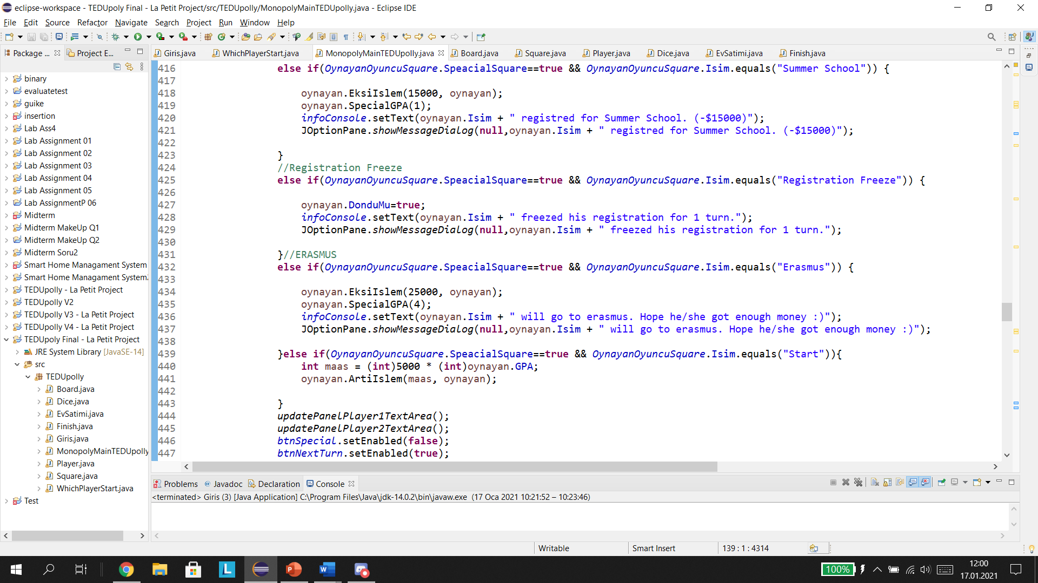

Slide 19
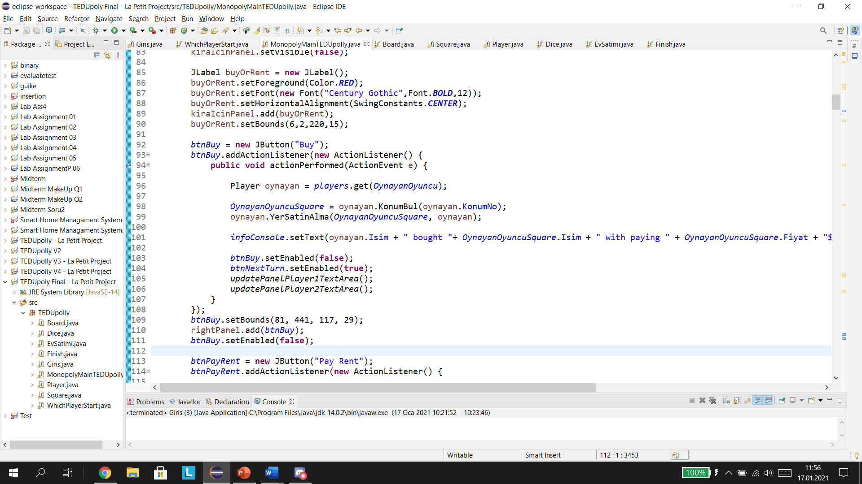
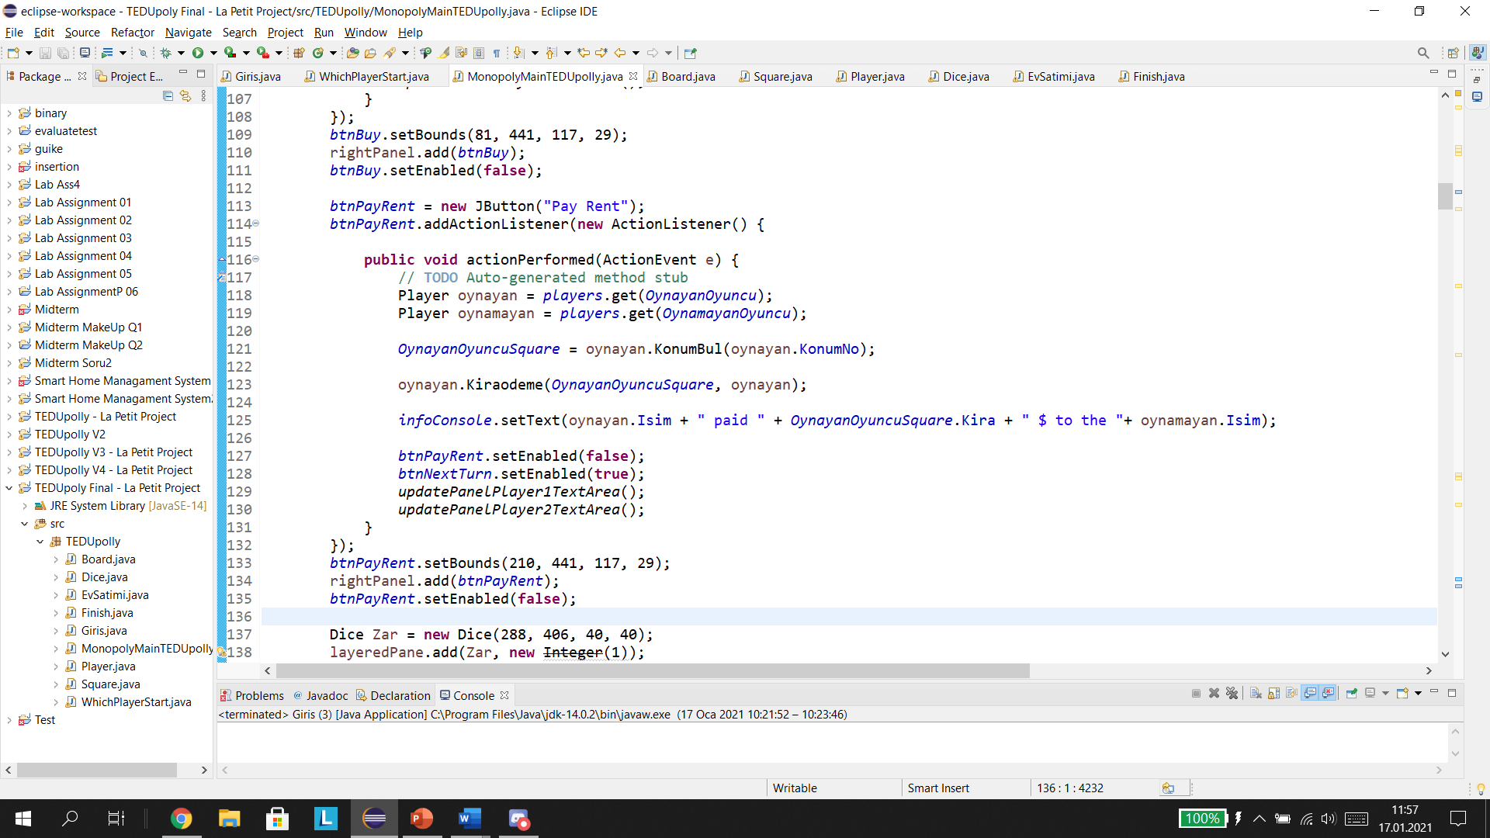

Slide 20
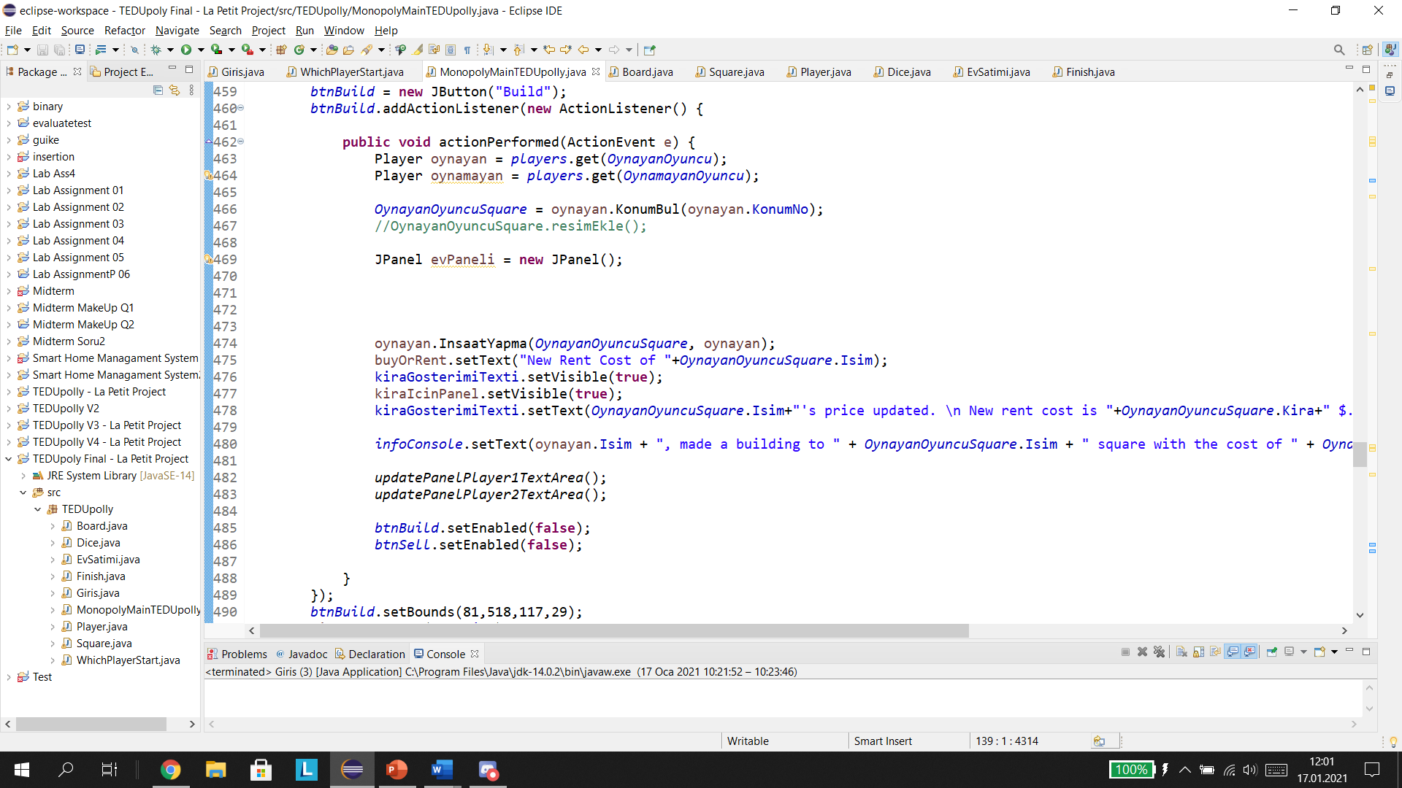
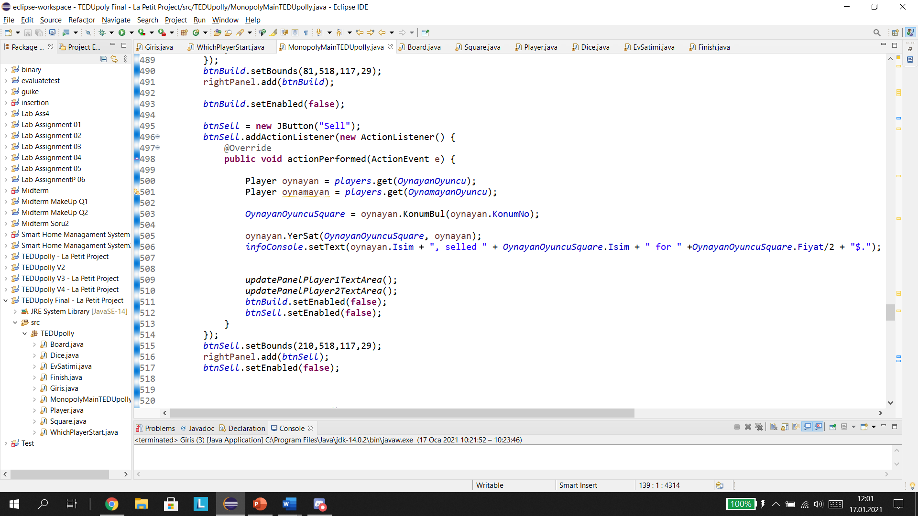

Slide 21
